Slide 1




Original Webpage Image
Segmented Images
Code Segments
Combine Code
Final Webpage
Image
Image Segmentation

Slide 2
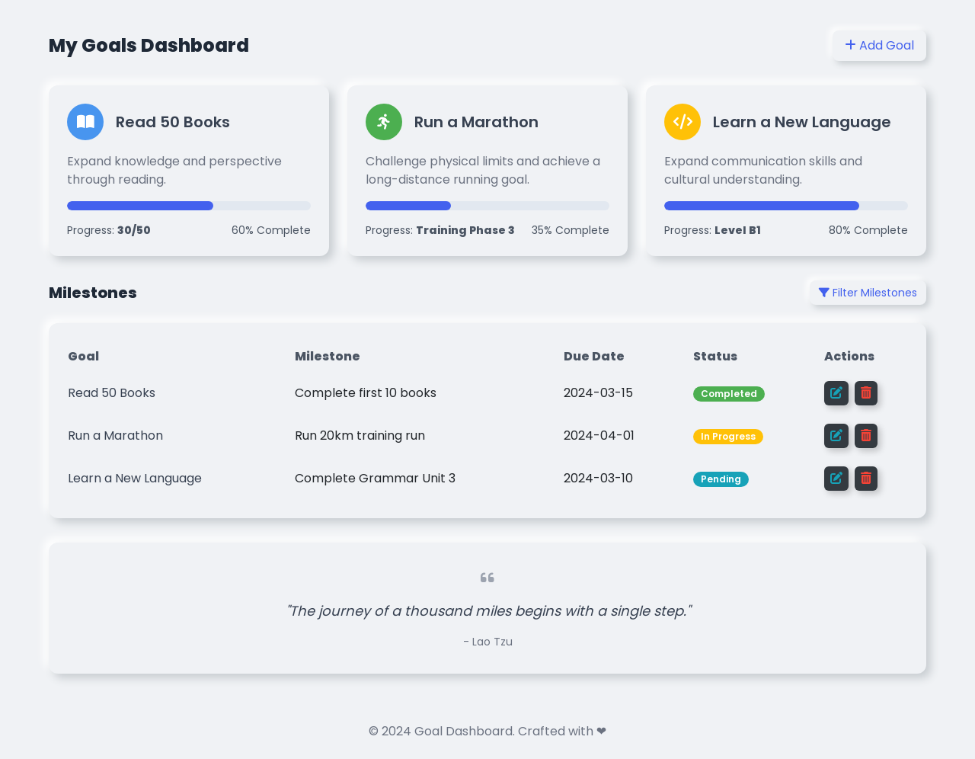
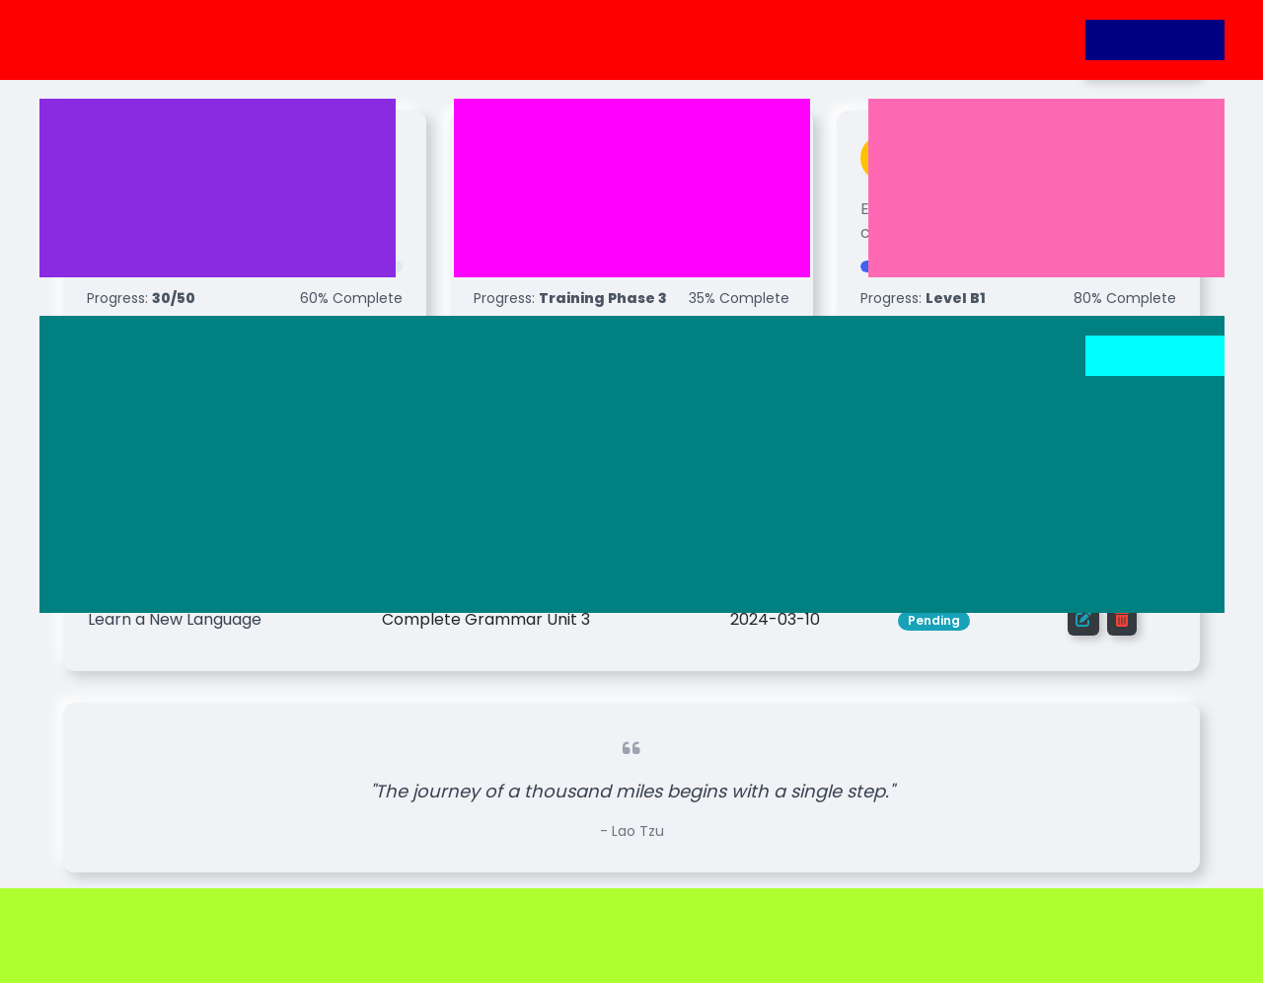






Original Image
LLM Segments
Fixed-Size Segments
Overlapping Segments

